Slide 1
Revenue Analysis, Staffing Needs, and Discount Strategies for Columbia Asia Hospital

Slide 2
Problem statement
Columbia Asia Hospital seeks to enhance its operational efficiency by maximizing revenue, identifying departments with staffing needs, and implementing patient discount strategies. The hospital aims to analyze its current revenue generation patterns, determine high-traffic departments requiring additional hires, and create discount policies to improve patient satisfaction and retention while maintaining profitability.

Slide 3
Data Description
Date: This column contains date and time information without specifying AM or PM. The format is DD-MM-YYYY HH:MM.
Patient ID: Each patient is assigned a unique identifier, which seems to be in the format 124-62-3289.
Patient Gender: This column records the gender of the patient, denoted by 'M' for male and 'F' for female.
Patient Age: The age of the patients is listed in years.
Patient Sat Score: It seems to represent a satisfaction score given by or for the patient. However, the scores are single-digit, and it's not clear what the scale is.
Patient First Initial: This column contains the first initial of the patient's first name.
Patient Last Name: The surname of the patient is listed in this column.

Slide 4
Patient Race: The racial or ethnic background of the patient is recorded here, with categories such as 'White', 'African American', 'Asian', 'Native American/Alaska Native', and 'Two or More Races'.
Patient Admin Flag: This column contains boolean values ('TRUE' or 'FALSE') which might indicate whether the patient was admitted or some other administrative flag.
Patient Wait Time: Appears to indicate the time the patient waited, possibly in minutes, before being seen or processed.
Department Referral: This column lists the department to which the patient was referred, with entries such as 'General Practice', 'Orthopedics', 'Gastroenterology', or 'None' indicating no referral.
Doctor Name: Identifies the doctor who attended each patient.
Appointment Fees: The cost charged for a doctor's consultation.
Total Bill: The overall amount billed to the patient, including all services and charges.

Slide 5
Functions and Tools used
Power Query Editor: Used to clean and prepare the dataset by addressing missing values and correcting data types.
DAX Functions: Functions like SUM(), AVERAGE(), CALCULATE(), and IF() were used to calculate key metrics such as total revenue, average wait times, and patient satisfaction.
Visualizations: Table, bar/column charts, and matrix visualizations were utilized to display revenue, patient visits, and satisfaction scores across departments.
Conditional Formatting: Applied in matrix visualizations to create a heatmap, showing patterns in patient satisfaction based on demographics.
Slicers and Filters: Enabled dynamic filtering of the data by department and time, helping refine insights on patient visits and departmental performance.

Slide 6
Key insights

Slide 7
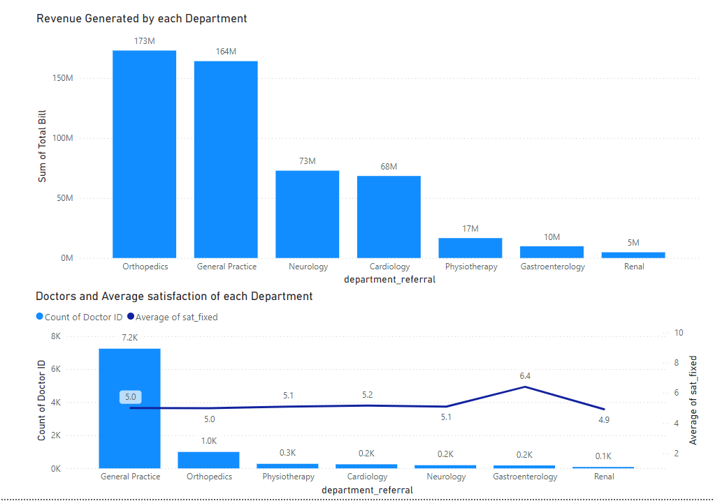
Revenue Generation
Insights:
Revenue Generation:
Orthopedics generated $173 million, and General Practice generated $164 million.
Neurology, with only 200 doctors, generated $73 million, indicating high revenue potential per doctor.
Doctor Distribution:
General Practice has the most doctors at 7,200, correlating with its high patient volume.
Recommendations:
Focus on Specialized Departments:
Enhance investment in specialized departments like Orthopedics and Neurology to boost revenue and improve patient care quality.

Slide 8
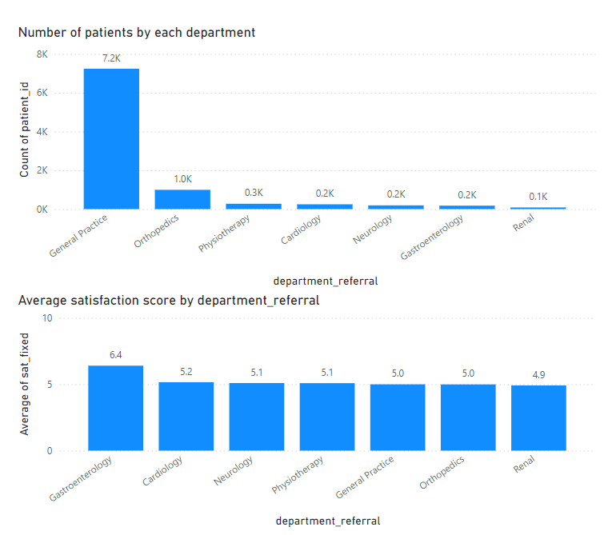
2. Suitable Departments for New Hires
Insights:
High Patient Load: Departments like General Practice and Orthopedics see a significantly higher number of patient visits.
Low Satisfaction Scores: Departments where patient satisfaction is low (e.g., Gastroenterology and Neurology) could benefit from hiring more doctors to reduce patient waiting times and improve care quality.
Recommendations:
The hospital should consider hiring more doctors in General Practice, Neurology, and Orthopedics, with a focus on staffing evening shifts to meet patient demand. Departments with higher patient dissatisfaction (like Neurology) should also be prioritized.

Slide 9
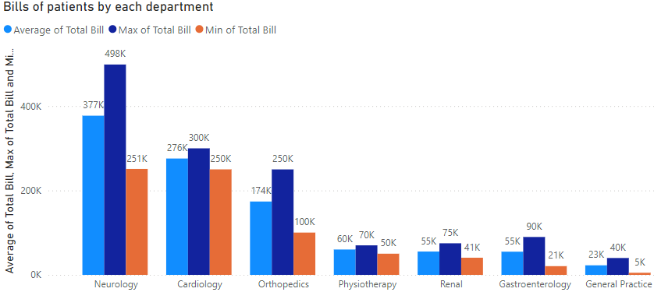
3. Strategies Suggestions for Patient Discounts
Insights:
Income-Based Discounts:
Offer discounts to patients with higher total bills, especially in departments like Neurology and Gastroenterology, to alleviate financial strain. A specific billing threshold can be set for eligibility.
Loyalty Discounts:
Provide discounts to patients with multiple visits or long-term treatments, particularly in Neurology and Physiotherapy, to encourage ongoing care and retention.
Recommendations:
Implement income-based discounts for high-bill patients and loyalty-based discounts for frequent visitors, especially in high-volume departments like General Practice.

Slide 10
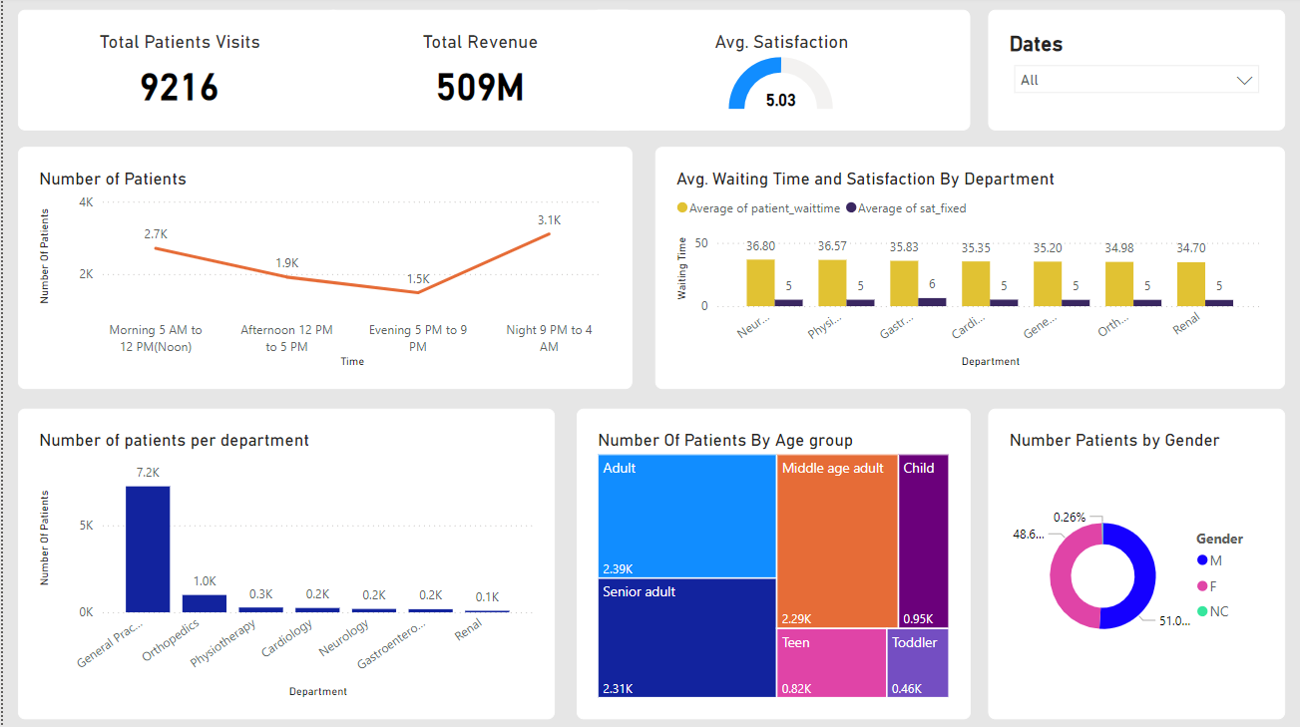
Main Tab

Slide 11
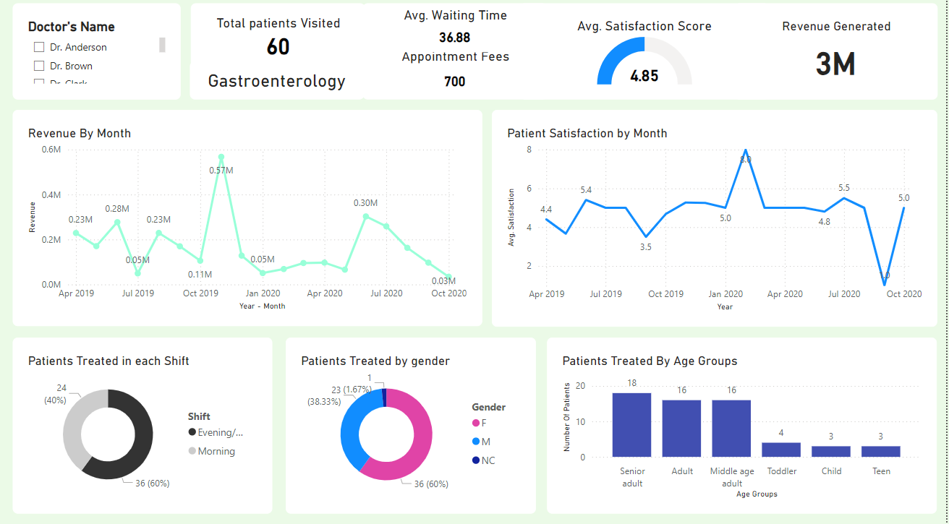
Doctor’s Tab

Slide 12
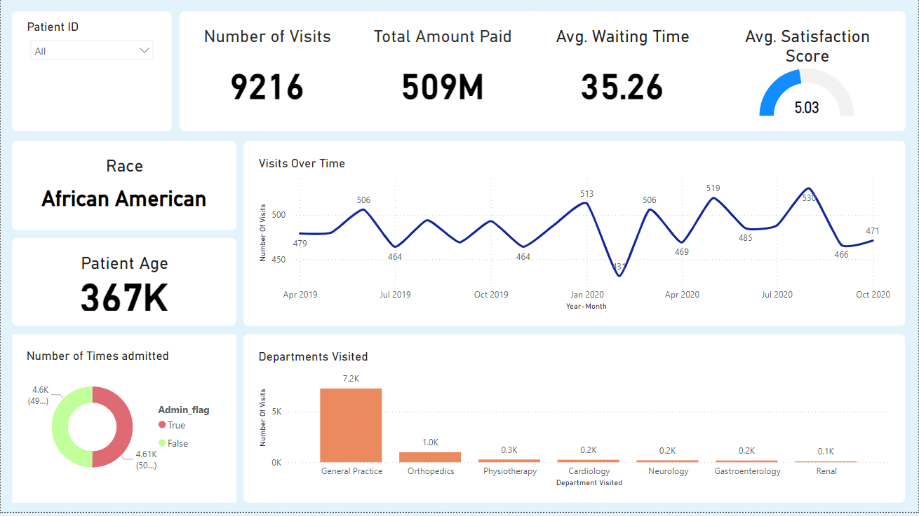
Patient Tab

Slide 13
Conclusions
Revenue Potential: Specialized departments like Orthopedics and Neurology are key revenue generators.
Doctor Efficiency: High revenue per physician in departments like Neurology suggests opportunities for staffing optimization.
Discount Strategies: Implementing income-based and loyalty discounts can enhance patient satisfaction and retention.
Focus on Specialization: Prioritizing investments in specialized departments will drive revenue growth and improve care quality.

Slide 14
Recommendations
Invest in Specialized Departments: Focus on expanding services and resources in high-revenue departments like Orthopedics and Neurology.
Optimize Staffing Levels: Adjust the number of doctors in specialized departments to maximize revenue per physician.
Introduce Income-Based Discounts: Implement discounts for patients with high bills, particularly in Neurology and Gastroenterology, based on a set billing threshold.
Establish Loyalty Programs: Create discounts for patients who frequently visit or require long-term treatments in departments like Neurology and Physiotherapy.
Leverage Data Analytics: Use data insights to monitor revenue trends and patient satisfaction, guiding strategic investments and operational improvements.

